Slide 1
Rolling a Pair: Optimizing the Chances of a Double Play Ball
Bill Petti
Saber Seminar
August 6, 2017
@BillPetti | billpetti.github.io

Slide 2
Motivation for the study
1
Double plays can have a large impact on the expected runs of an inning and are of strategic value to teams (both inducing and avoiding them)
On average, double plays drop the run expectancy of an inning from 1.59 to 0.12 with 0 outs; wipes out 1.02 runs on average when there is 1 out

Slide 3
Motivation for the study
1
Double plays can have a large impact on the expected runs of an inning and are of strategic value to teams (both inducing and avoiding them)
2
Double plays are relatively rare events based on balls in play. Understanding how to even marginally increase their odds should be valuable
Only 3.2% of all batted balls turn into two outs
Only 15.2% of double play opportunities are converted

Slide 4
Data and Methodology Details
All pitches that resulted in balls in play from 2015 through 2016
Data courtesy of FanGraphs and Statcast via BaseballSavant
DATA
We are interested in traditional double play opportunities where teams might logically want to induce a double play
These are defined as having the following features:
Less than 2 outs
Runners on first base, first and second, first and third, or bases load
DEFINITIONS

Slide 5
Phases and Analytical Plan
Classifying batted balls that are likely to result in double plays
Given how a ball is struck—velocity, vertical angle, horizontal or spray angle—what is the likelihood that it results in a double play?
Classification model then applied to all batted balls to provide likelihood scores for “double play balls”
PHASE 1
Modeling the situational characteristics that increase the likelihood of inducing batted balls that lead to double plays
Velocity, Spin Rate, Vertical and Horizontal Location, Movement, etc.
Given specific batters and pitchers, what type of pitch will increase the likelihood of inducing a double play ball?
PHASE 2
Developing a tool to optimize double play opportunities
Given the pitchers and batters involved in a given plate appearance, what kind of pitch will maximize the likelihood of a double play if contact is made
PHASE 3
I will focus on Phases 1 & 2 for today

Slide 6
Classifying double play batted balls
PHASE 1

Slide 7
Distribution of Ground Ball Double Plays by Batter Handedness: Exit Velocity

Slide 8
Distribution of Ground Ball Double Plays by Batter Handedness: Launch Angle

Slide 9
Regardless of handedness, the combination of launch angle and exit velocity look similar by handedness
Highest frequency between 0 & -10 degrees and 95-100 mph

Slide 10
Distribution of Ground Ball Double Plays by Batter Handedness: Spray Angle

Slide 11
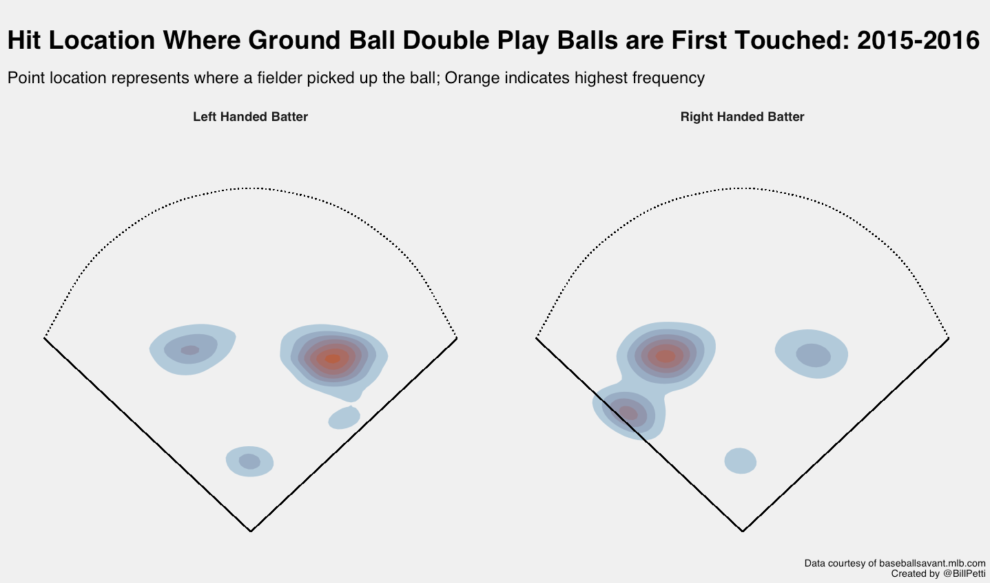

Slide 12
Double Play Modeling Notes
successful_double_play ~ hit_angle + hit_speed + spray_angle + stand
The features are on different scales, so feature engineering makes sense here
The imbalanced nature of the data needs to be accounted for
Could guess against a double play every time and technically have 83.7% accuracy; that doesn’t exactly help us
Approaches to deal with imbalance: resampling, down-sampling, tree-based models that handle imbalance better, quality measures other than Accuracy (e.g. ROC) to select best model
6 different types of models were tested (Logistic Regression, Bayesian GLM, LDA, CART, Gradient Boosting Machines, and Random Forest)
Each model was fit using all hitters with imbalance intact, splitting by handedness with imbalance, and all hitters with down-sampling

Slide 13
Double Play Classification Results
Tree-based and ensemble models performed the best
Random Forest (RF) and Stochastic Gradient Boosting (GBM) models performed very similar across a number of metrics
Down-sampling (ds_) improved all models, including RF and GBM
RF and GBM superior when taking into account multiple measures that balance different aspects of accuracy (i.e. F1, AUC, Balanced Accuracy)

Slide 14
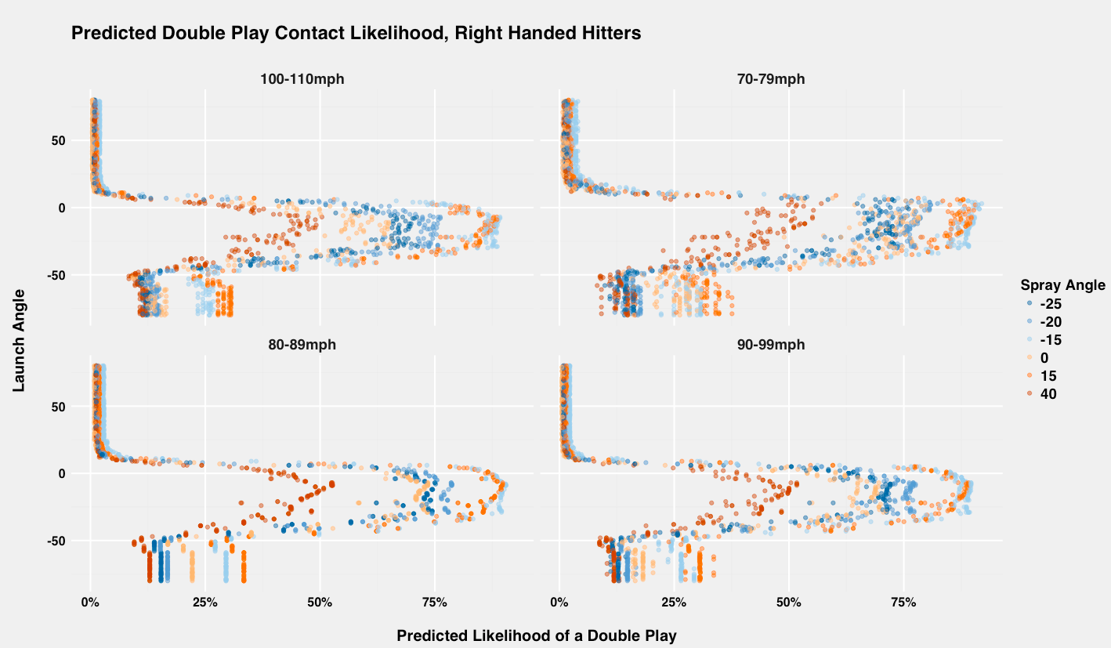
Launch Angle does most of the work, with Spray Angle and Exit Velocity a distant second and third
As expected, Launch Angle is the most important variable, but it’s influence is non-linear; more complicated than “hit the ball on the ground”
Spray Angle is the next most important variable; probabilities move significantly based on hitting the ball to different areas of the infield, holding launch angle constant
Exit Velocity is the weakest variable, but it does some work to be sure. It’s impact is about half as much as spray angle

Slide 15
How I’m feeling after Phase 1

Slide 16
Predicting the inducement of a ground ball double play
PHASE 2

Slide 17
Double Play Contact Modeling Notes
The down-sampled GBM was chosen as the initial model to use for assigning probabilities or class of double play contact
Applied to all batted balls, 2015-2016 (n = 216,866)
Initial list of features to use to predict double play contact based off of a pitch:
Vertical location (pz) | Velocity (start_speed)
Horizontal location (px) | Batter handedness (stand)
Vertical movement (pfx_z) | Pitcher handedness (p_throws)
Horizontal movement (pfx_x) | Batter ID (batter)
Release Spin rate (release_spin_rate) | Pitcher ID (pitcher)

Slide 18
Double Play Contact Modeling Notes
double_play_contact ~ px + pz + pfx_x + pfx_z +
start_speed + release_spin_rate + stand + p_throws
Continuous features were scaled and centered
Initially, tried predicting the continuous probability of double play contact
Logistic Regression, Generalized Additive Models, CART, Ridge Regression, Lasso Regression, and Gradient Boosting Machines
The results were underwhelming
GBM performed the best, but with a MAE of .307
Next up was using basic classification
Down-sampling was used just as in Phase 1
Logistic Regression, GLM, CART, Gradient Boosting Machines, Random Forest, Generalized Linear Mixed Model (binomial and poisson, included random effects for batter, pitcher, stand, and p_throws)

Slide 19
Double Play Contact Modeling Notes
The results are less impressive than Phase 1, although better than a “random” model
The non-down sampled GLMM using a Poisson distribution and a .30 cut point appears to perform best across most of the metrics, but it’s close
The random effect for batter was four times as large as for pitcher
Vertical location was the largest fixed effect (-.28), followed by vertical movement (-.0489) and velocity (.036)

Slide 20
How I’m feeling after Phase 2

Slide 21
Wrapping Up/Next Steps
Modeling the type of contact that results in a ground ball double play appears solid
Improvements may be likely by playing with the cut point at which a probability is coded as a success or failure
Controlling for the batter’s speed may also improve the predictive power of the model and, therefore, the specific type of optimal contact
Modeling the type of pitch to best induce the contact still needs work
Accounting for the batter seems important (hypothesis is certain types of swings moderate impact of pitch location, movement, etc.), but could also use average hit angle, exit velocity, etc. instead of a fixed effect.
Pro: Would make other algorithms more practical, avoid using “average” batter factor where sample is low/missing
Con: Lose some transparency
Slides are available at: https://github.com/BillPetti/double_play_balls/tree/master
Refined work will be published in the coming months at FanGraphs or The Hardball Times

Slide 22
Thank You

